Slide 1
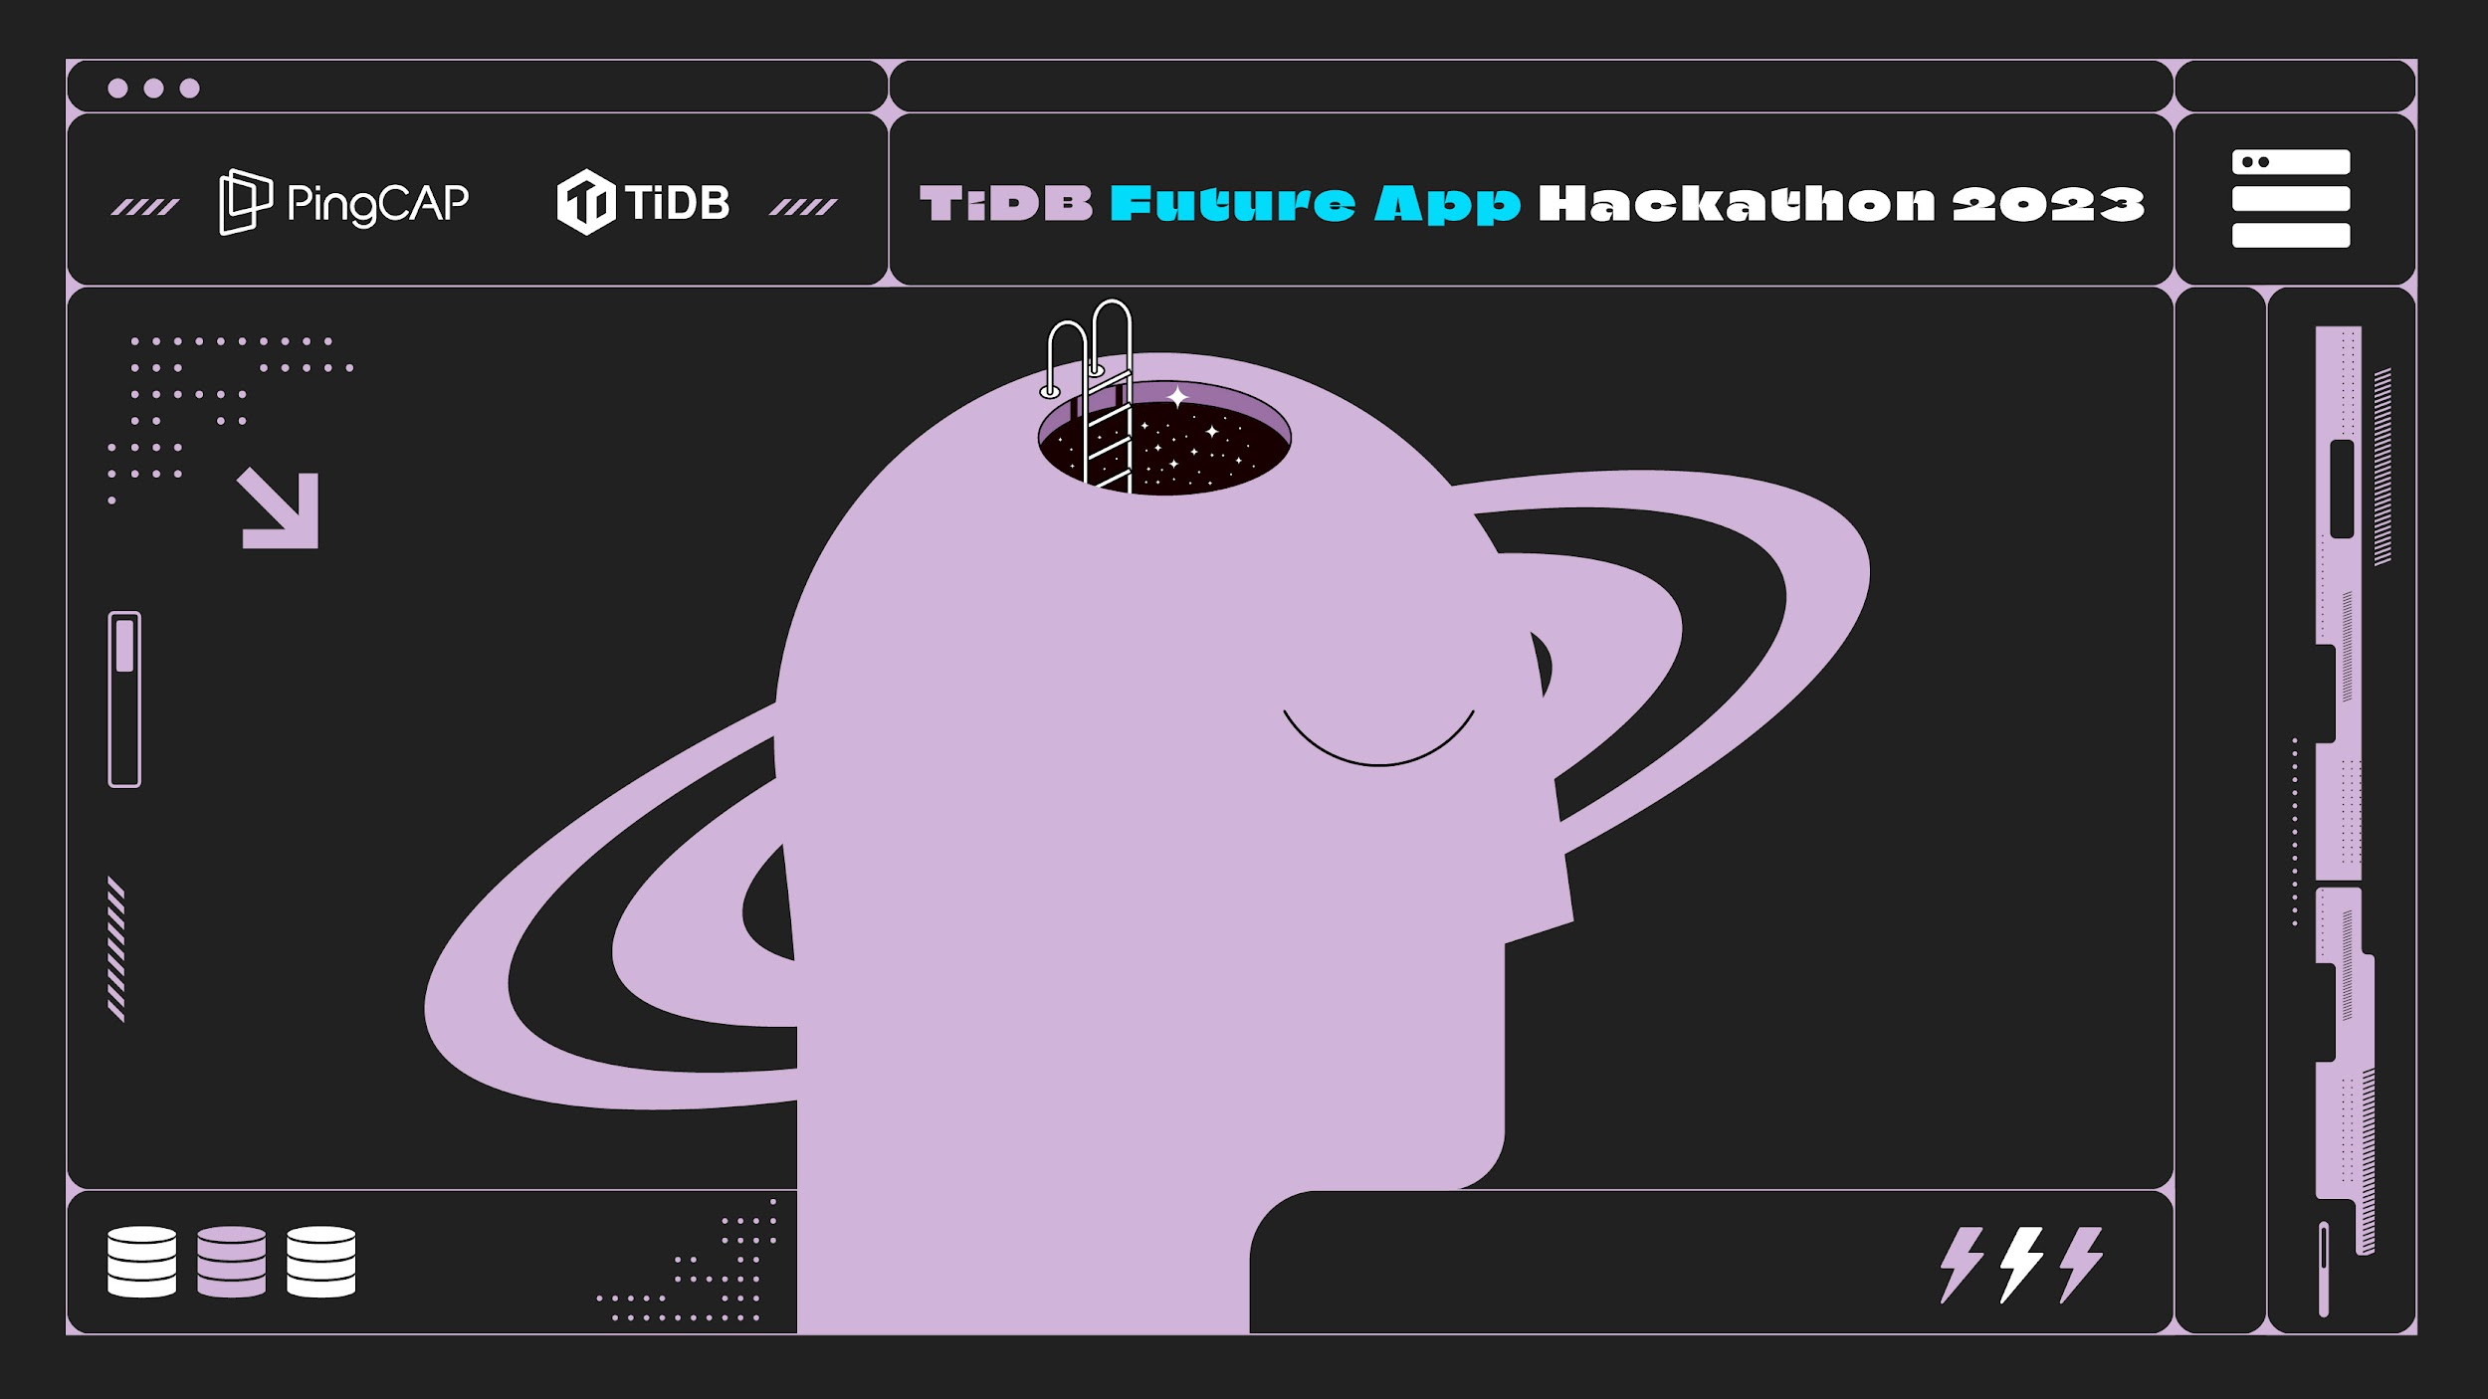
Project Name

Slide 2
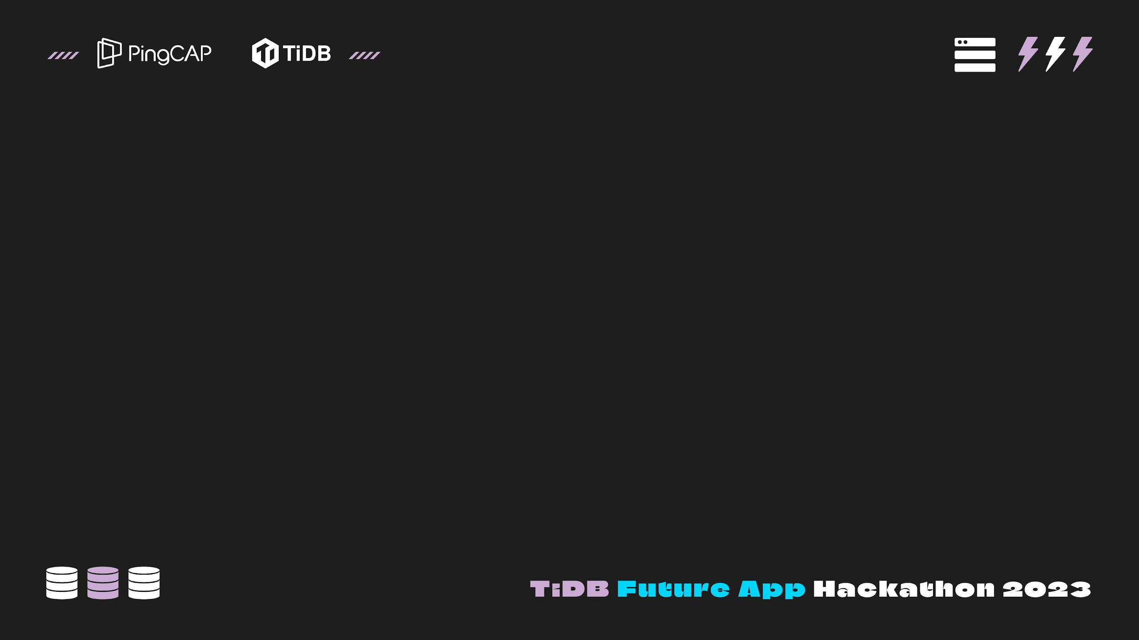
Description : *Note: This is just a description page about the requirement of demo video, it does not need to be included in the final PPT page, you can delete this page at any time.
Submission of a video demonstration of your application (PPT presentation (optional) + application demo)
The video should be uploaded to YouTube and publicly viewable
Upload your video to YouTube. It can be unlisted, but must be viewable via link
Copy and paste the YouTube link to the designated submission portal
Time should not exceed 4 minutes.
Work Requirements:
Must be the original work of the submitter, owned exclusively by the submitter, and not infringe upon any other individual or entity's intellectual property rights.
Must use TiDB Serverless for application development.
The submitted work must be a runnable demo.
The work must not include any elements of cultural, regional, gender discrimination, political inclination, or violate others/public privacy.
Language requirements: all submission materials must be in English; if not, participants must provide English translations for the demo video, text description and testing instructions, and all other submission materials.

Slide 3
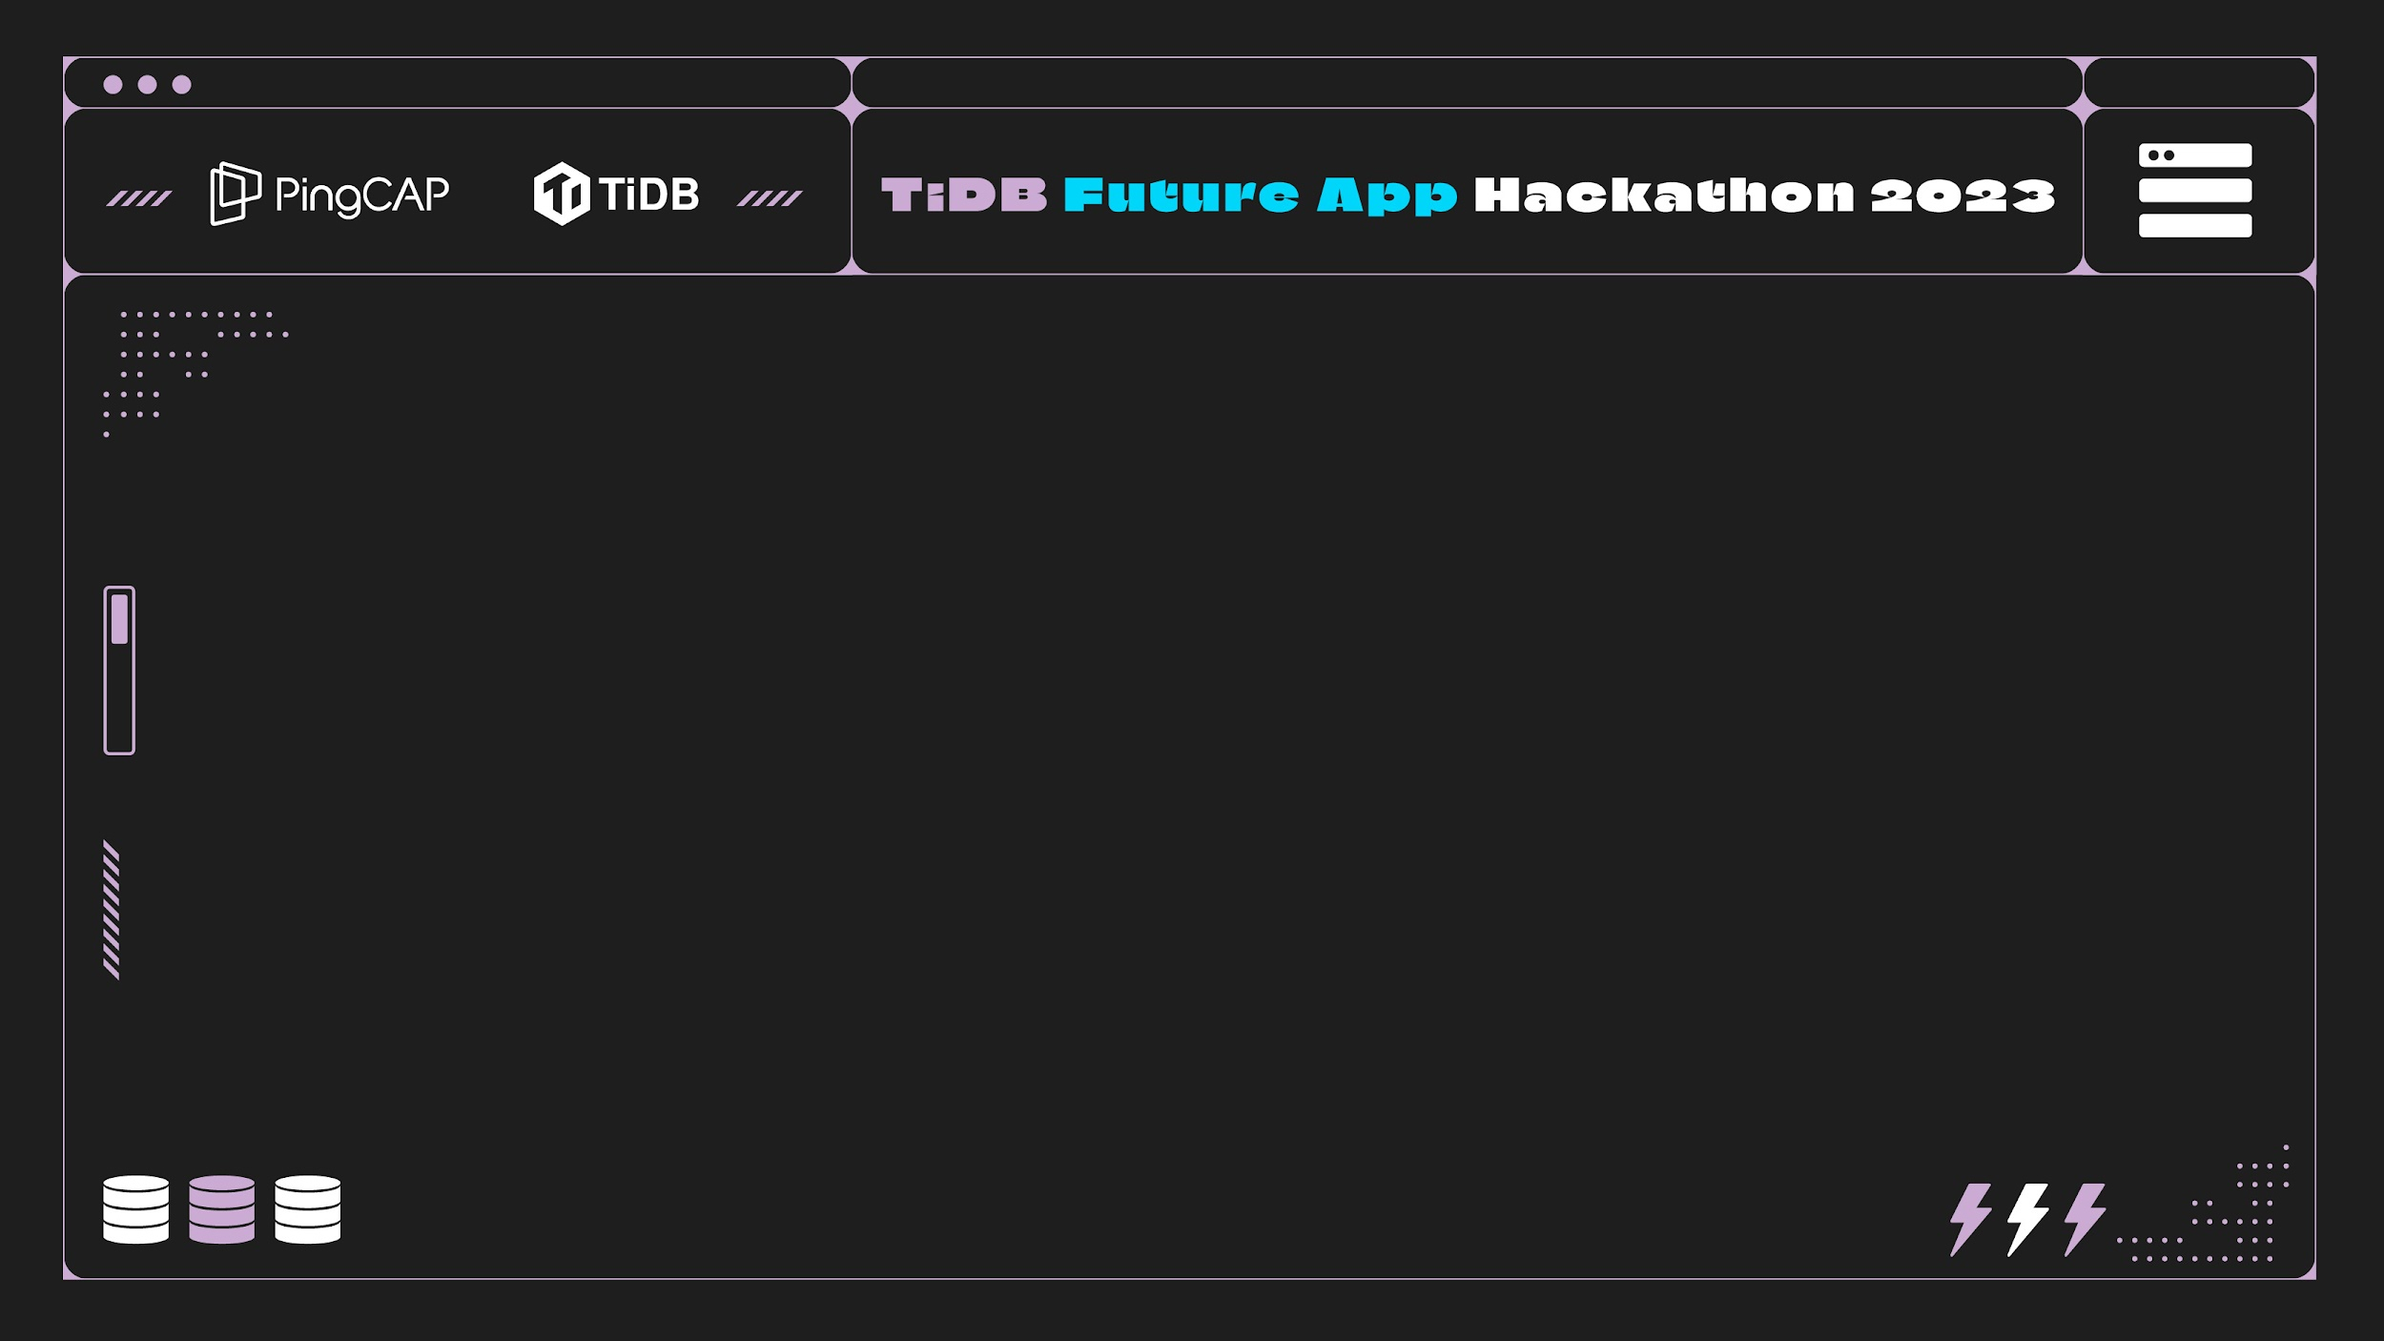
Team Name & Team Introduction

Slide 4
Click to add your team name & team introduction

Slide 5
Project Introduction

Slide 6
Click to add your project introduction
Target audience
What problem are you solving or what user needs are you addressing?
How are you addressing the problem/need from the user's perspective?

Slide 7
Application Demo

Slide 8
Click to add your application demo:
How did you integrate TiDB Cloud serverless into your project?
Demonstration of application features and user flows
Brief overview of your technology
From a technical standpoint, how did you solve key problems?
What unique features have you built into the application?
What are the main product qualities or achievements you want to highlight?

Slide 9
Future Plan

Slide 10
Click to add your development progress of the project

Slide 11
Click to add the development plan for the remaining part of the hackathon

Slide 12
Thank you

